Slide 1
Raspberry Pi Attendance System
RFID Attendance System
Assembled and Designed By: John Hall
Created By: Pi up my life

Slide 2
Description of Product
This attendance system will log data that is tapped to the RFID sensor. Once data is created for a user on the Raspberry Pi, the user will tap his/her card to it upon entering the designated room. Data will consist of the date and time at which the student arrived or left, the name of the student with their Tag’s unique ID number and any other relevant minimal data that may be associated with the user. This data is then sent to an SQL database where it is displayed on a simple web interface. This web interface will allow you to check the user's attendance and view when they tap their RFID card to the reader.

Slide 3
Task | Activity Description
Task 1 | RFID Setup
Task 2 | Prepare Raspbian
Task 3 | Build RFID RC522 Reader Circuit and Enable SPI
Task 4 | Enable the correct Kernel Module
Task 5 | Create Python to Read/Write data to RFID Tags
Task 6 | Test the RFID reader
Task 7 | Database Creation
Task 8 | Install MySQL
Task 9 | Setup Secure Installation
Task 10 | CREATE DATABASE attendance;
Task 11 | CREATE USER
Task 12 | Creating and Recording Multiple Users
Task 13 | Create Python to write data to database
Task 14 | Check Database
Task 15 | Check Attendance
Task 16 | Database Maintenance and Design
Task 17 | NGINX and PHP for Web Interface
Task 18 | GitHUB Cloning
Task 19 | URL testing
Task 20 | Troubleshooting
Task 21 | Advanced Troubleshooting
Task 22 | Design Hardware Housing
Task 23 | Order Hardware Housing
Task 24 | Create Hardware Housing
Task 25 | Design User Manual
Task 26 | Create and Organize User Manual
Task 27 | User Testing
Task 28 | Implementation

Slide 4
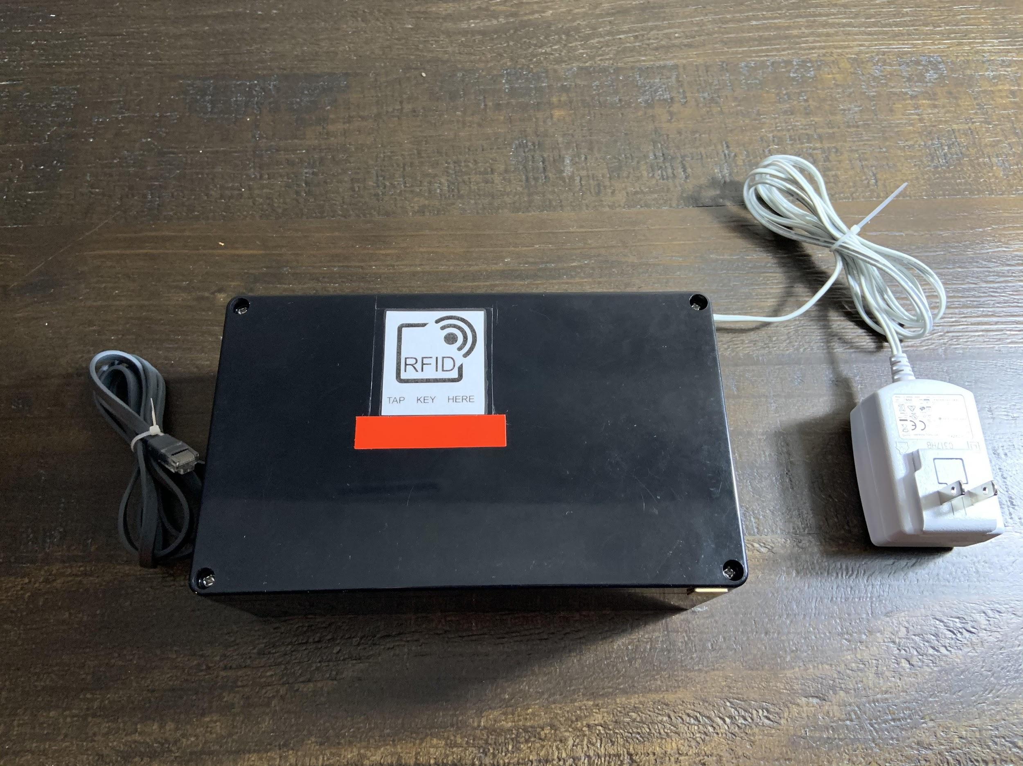
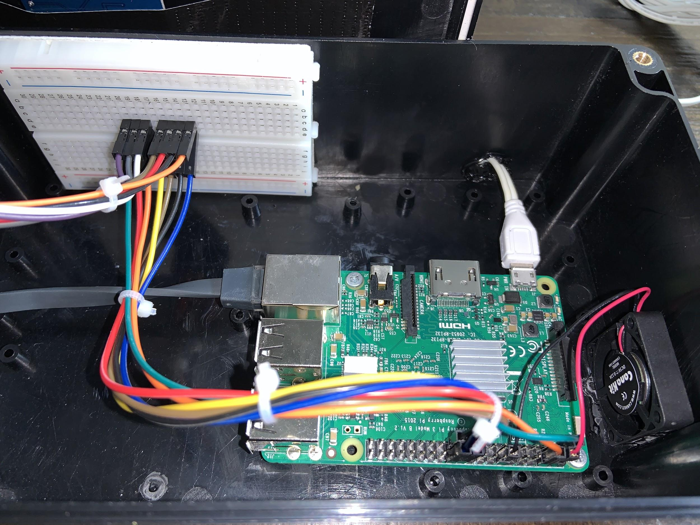
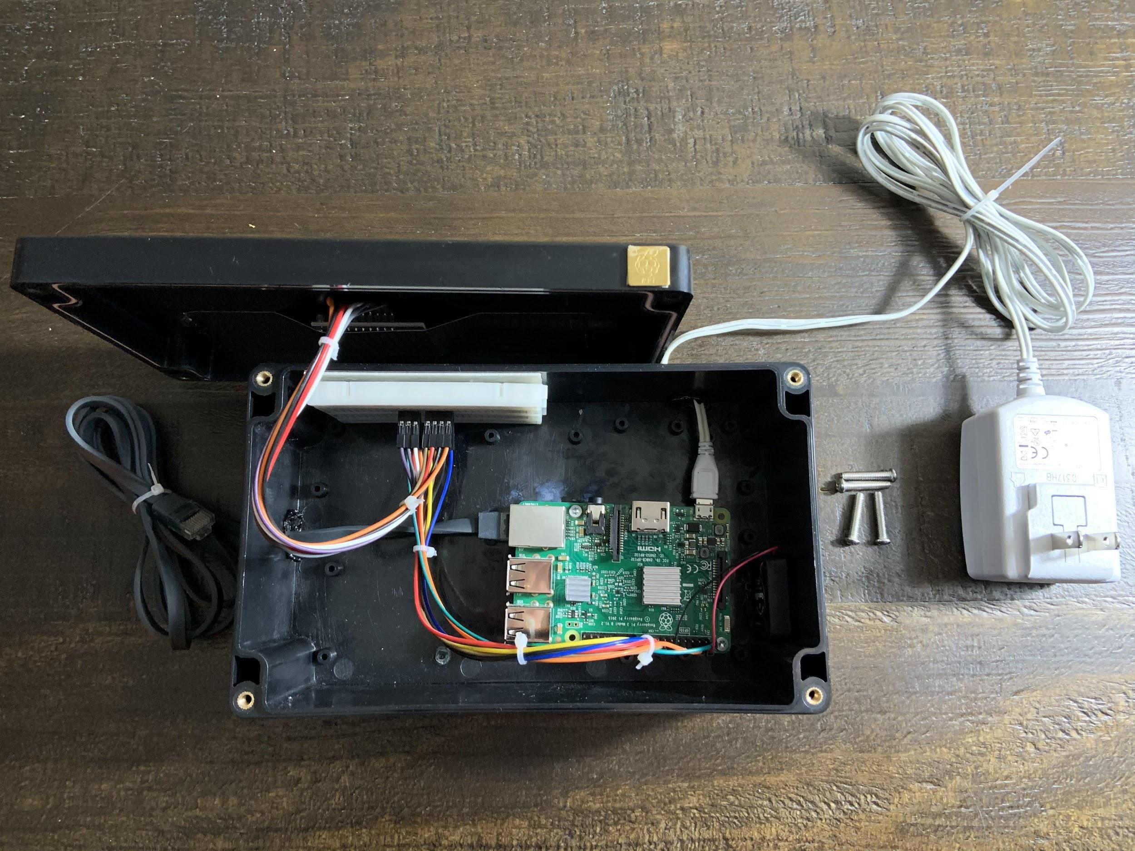
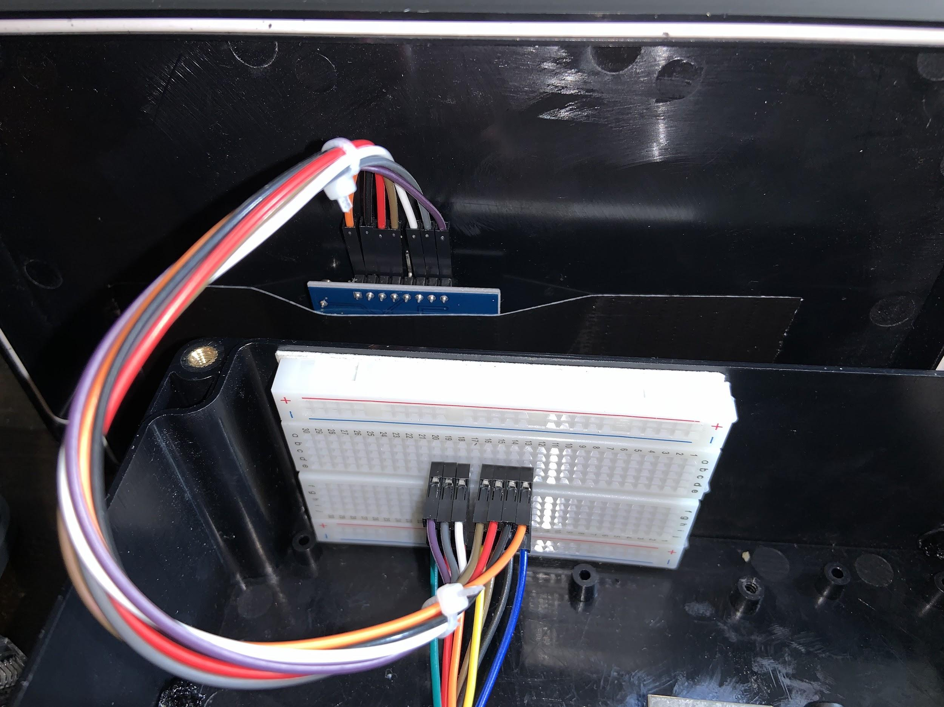
< System Overview
Hardware Setup >
< Hardware Overview
RC522 Setup >

Slide 5
check_attendance.py
Python Code (Need notes for each line.)
save_user.py
import time
import RPi.GPIO as GPIO
from mfrc522 import SimpleMFRC522
import mysql.connector
db = mysql.connector.connect(
host="localhost",
user="attendanceadmin",
passwd="astate1",
database="attendancesystem"
)
cursor = db.cursor()
reader = SimpleMFRC522()
try:
while True:
print('Place Card to\nrecord attendance')
id, text = reader.read()
cursor.execute("Select id, name FROM users WHERE rfid_uid="+str(id))
result = cursor.fetchone()
if cursor.rowcount >= 1:
print("" + result[1])
cursor.execute("INSERT INTO attendance (user_id) VALUES (%s)", (result[0],) )
db.commit()
else:
print("User does not exist.")
time.sleep(2)
finally:
GPIO.cleanup()
import time
import RPi.GPIO as GPIO
from mfrc522 import SimpleMFRC522
import mysql.connector
db = mysql.connector.connect(
host="localhost",
user="attendanceadmin",
passwd="astate1",
database="attendancesystem"
)
cursor = db.cursor()
reader = SimpleMFRC522()
try:
while True:
print('Place Card to\nregister')
id, text = reader.read()
cursor.execute("SELECT id FROM users WHERE rfid_uid="+str(id))
cursor.fetchone()
if cursor.rowcount >= 1:
print("Overwrite\nexisting user?")
overwrite = input("Overwite (Y/N)? ")
if overwrite[0] == 'Y' or overwrite[0] == 'y':
print("Overwriting user.")
time.sleep(1)
sql_insert = "UPDATE users SET name = %s WHERE rfid_uid=%s"
else:
continue;
else:
sql_insert = "INSERT INTO users (name, rfid_uid) VALUES (%s, %s)"
print('Enter new name')
new_name = input("Name: ")
cursor.execute(sql_insert, (new_name, id))
db.commit()
print("User " + new_name + "\nSaved")
time.sleep(2)
finally:
GPIO.cleanup()

Slide 6
SQL Commands
create table attendance(
id INT UNSIGNED NOT NULL AUTO_INCREMENT UNIQUE,
user_id INT UNSIGNED NOT NULL,
clock_in TIMESTAMP NOT NULL DEFAULT CURRENT_TIMESTAMP,
PRIMARY KEY ( id )
);
create table users(
id INT UNSIGNED NOT NULL AUTO_INCREMENT UNIQUE,
rfid_uid VARCHAR(255) NOT NULL,
name VARCHAR(255) NOT NULL,
created TIMESTAMP NOT NULL DEFAULT CURRENT_TIMESTAMP,
PRIMARY KEY ( id )
);

Slide 7
Video Demonstration (Close up and step-by-step in next slide.)

Slide 8
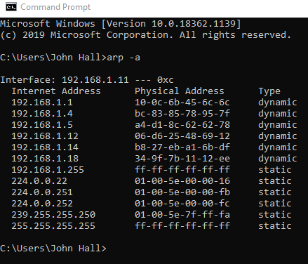
User Manual Example (Assuming User receives this system as-is.)
Step 1. Plug in Device to wall outlet and plug ethernet into router or switch.
Step 2. Open the Command Prompt on your Windows PC.
Step 3. Type the following command in the prompt:
arp –a
Step 4. Locate the MAC address of your Attendance System. This systems MAC address is:
B8:27:EB:A1:6B:DF
Step 5. Note the Internet Address on the left that corresponds to the Physical Address.
(For example, the current IP address for B8:27:EB:A1:6B:DF is 192.168.1.14 in the demonstration to the right.)

Slide 9
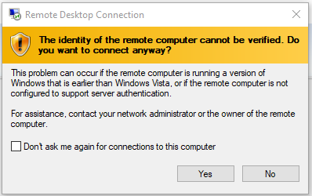
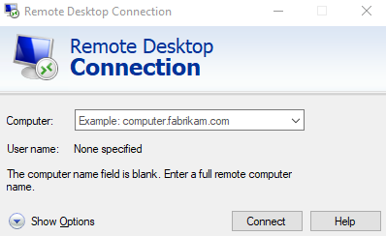
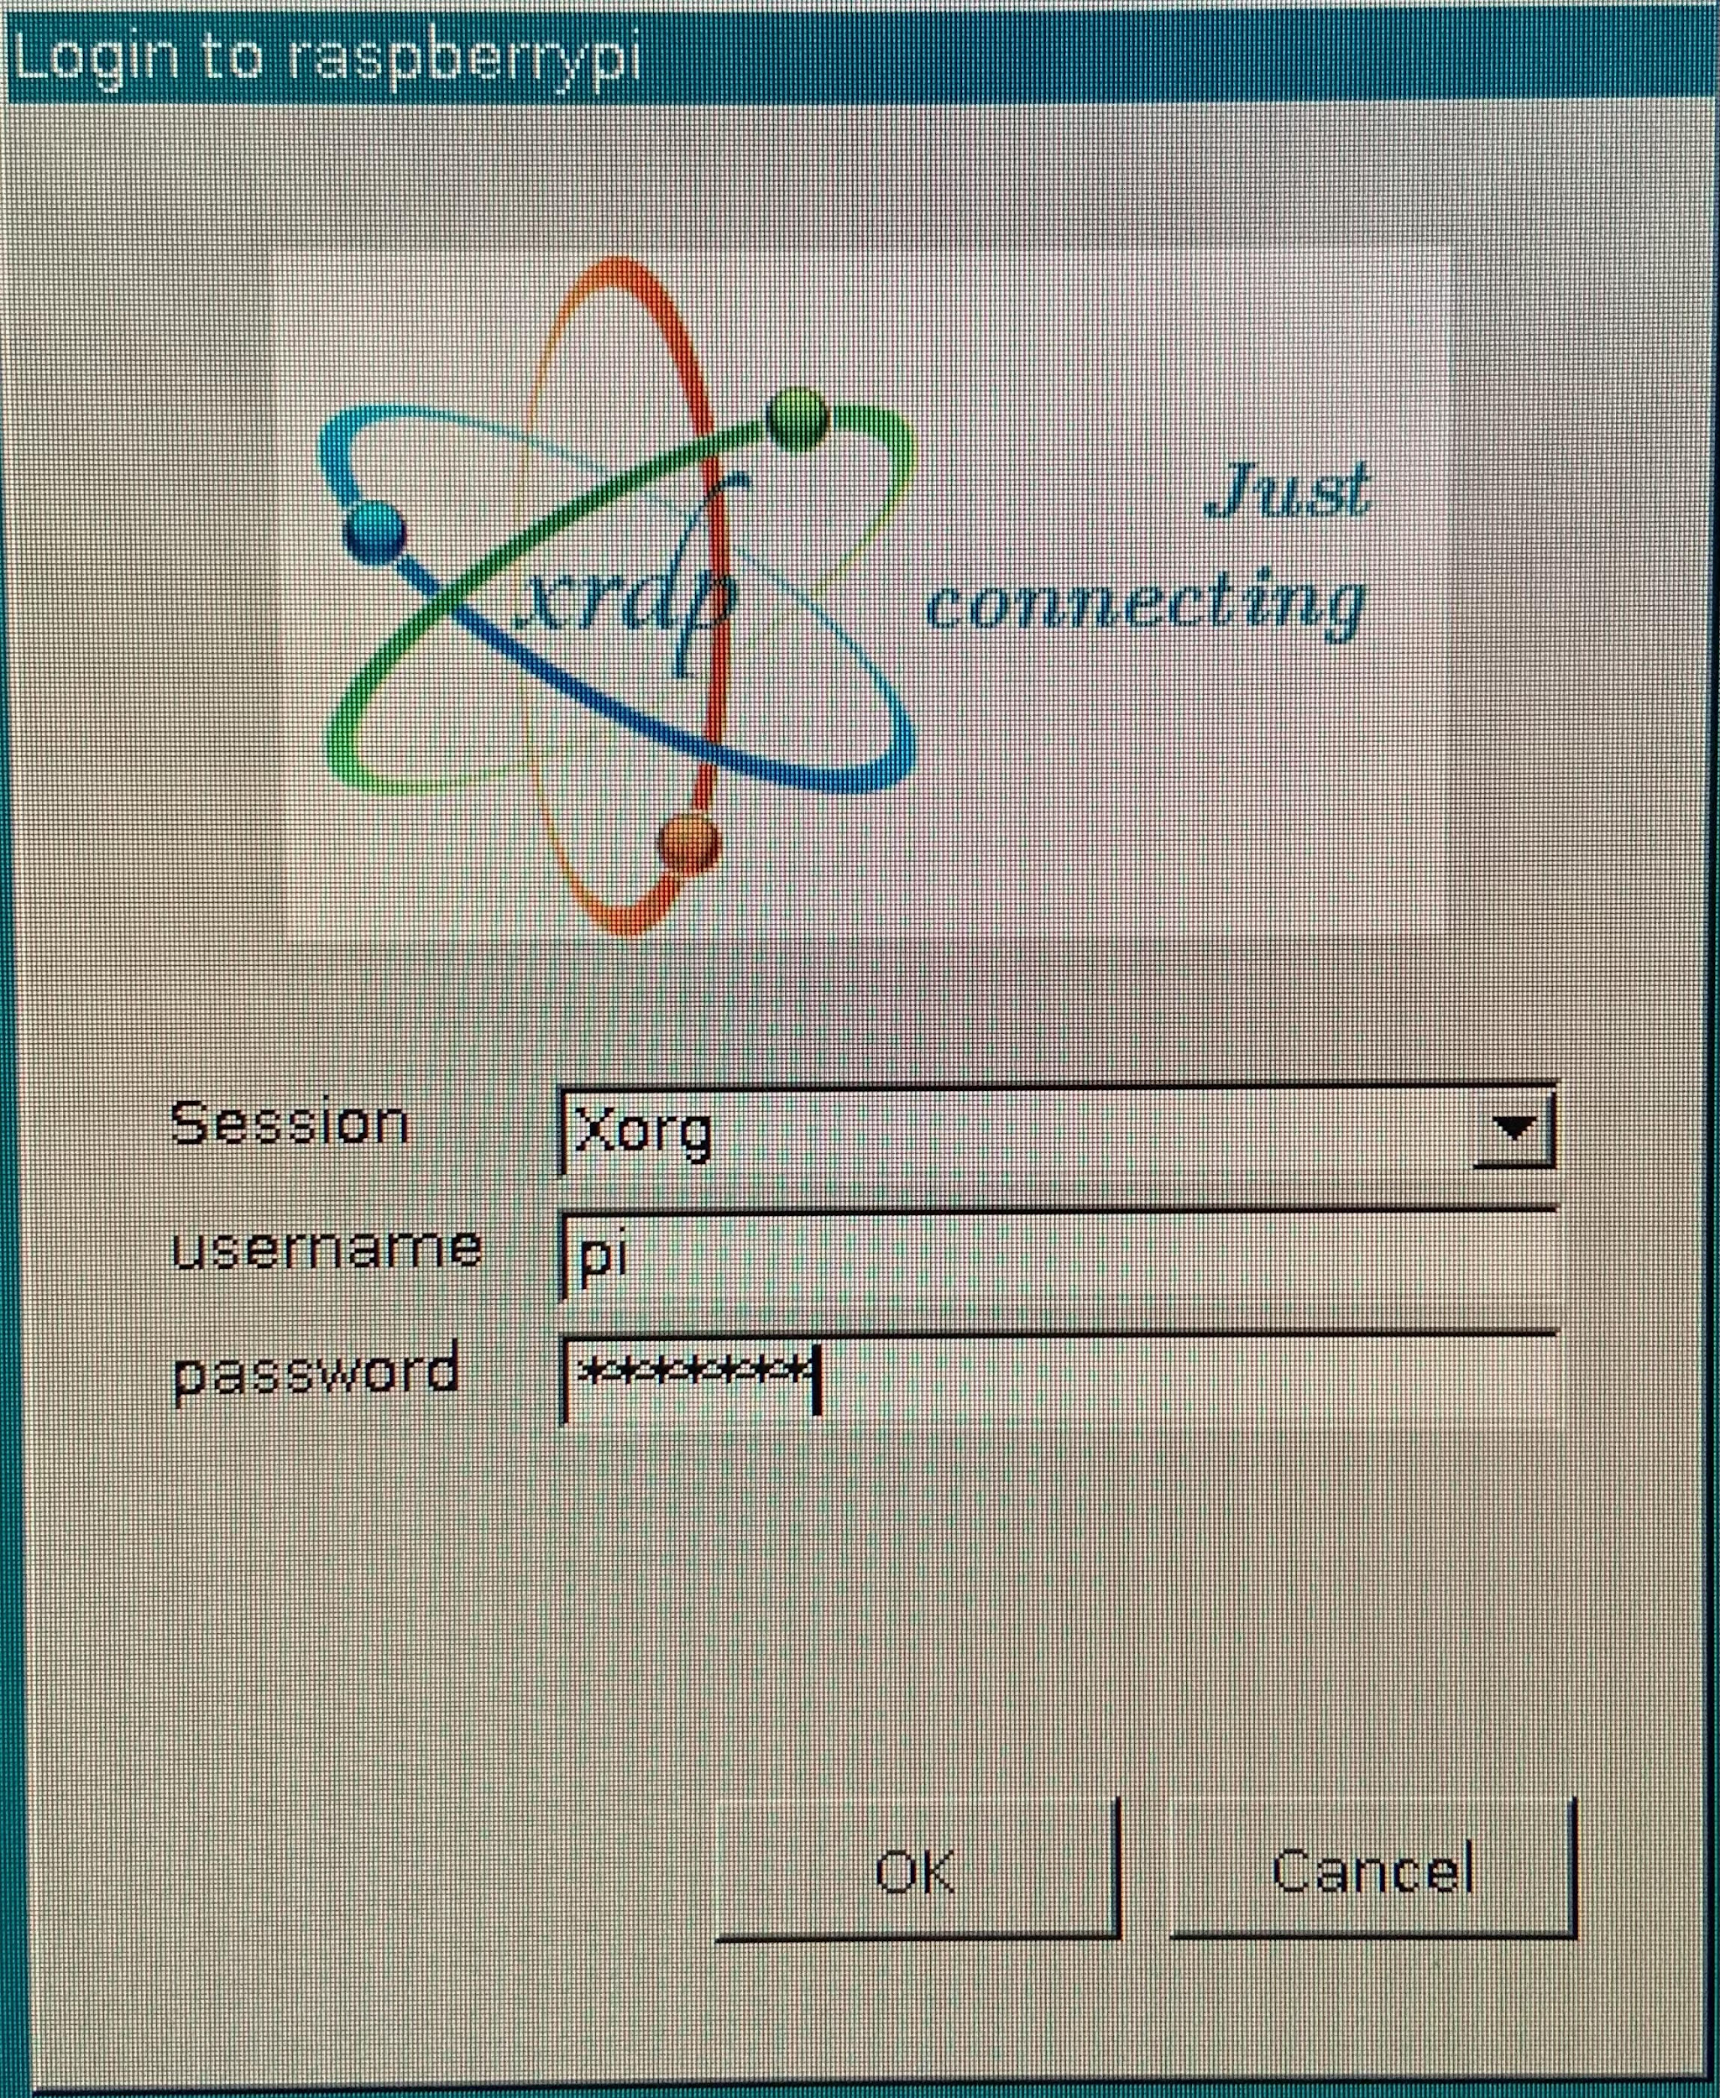
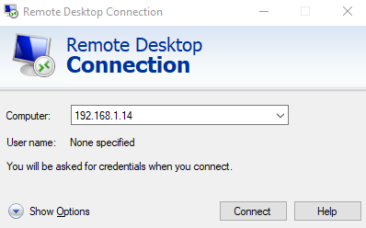
User Manual Example
Step 8.
Select Yes on the pop-up dialog box.
Step 9.
Type in the credentials for each the Username and Password. The credentials are as follows:
username: pi
password: A-State
Step 6.
Open the application Remote Desktop Connection on a Windows PC.
Step 7.
Type in the current IP Address that was noted from Step 5 in the search bar.

Slide 10
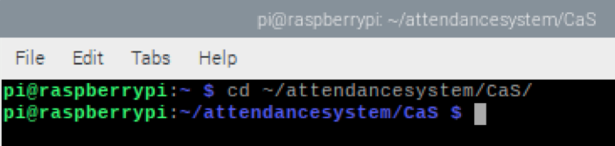
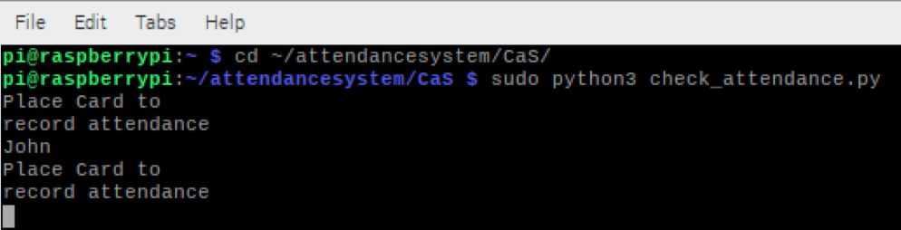
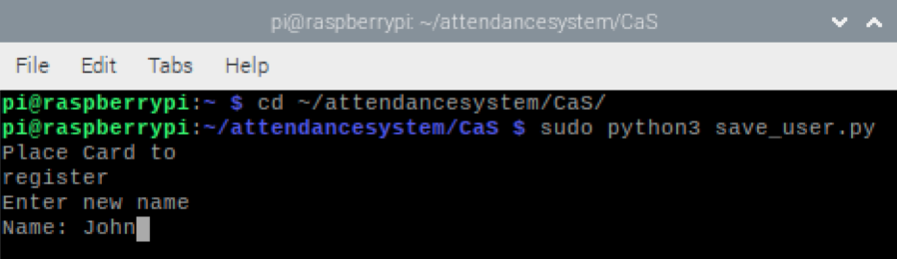
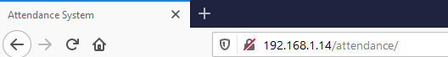
User Manual Example
Step 10.
Open the Terminal for the Pi and type the following command:
cd ~/attendancesystem/CaS/
Step 11.
Next, type the following command:
sudo python3 save_user.py
Step 12:
Place Tag on top of RFID sticker above the red line on top of device and type out any desired information that will be relevant to that specific RFID Tag.
Step 13.
To record a user’s attendance, type out the following command:
sudo python3 check_attendance.py
Step 14.
Repeat step 12.
Step 15. Go to any web browser and type the IP address followed by /attendance/ into the search bar. For example:
http://192.168.1.14/attendance/

Slide 11
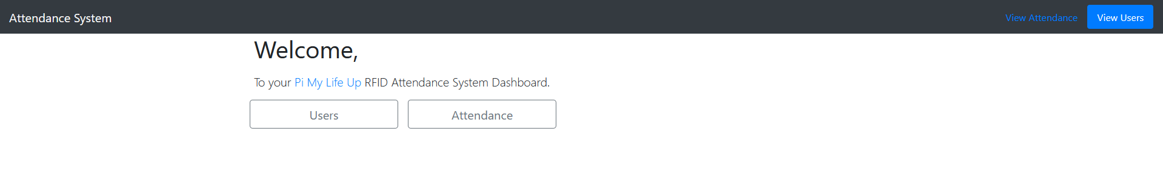
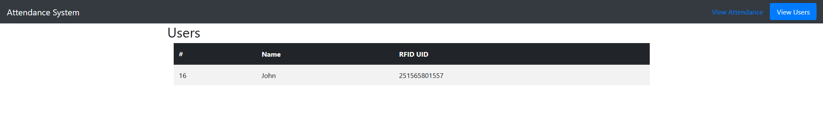
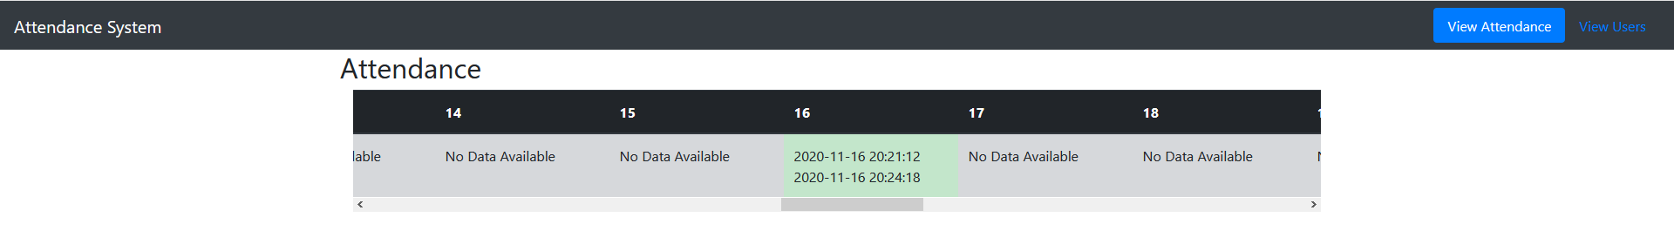
User Manual Example
Step 16.
Toggle between View Users and View Attendance on the Web Interface to view times checked in and out between users.
Step 17:
Select View Users to view all users registered to the system.
Step 18:
Select View Attendance to view all users registered to the system. (The data corresponds to the User, Date and Time. Information in the example below reflects the day this was recorded.)

